Slide 1
Cyber Security Attacks
Info 5709 Section 005-Project
Fall 2023-1
Data Visualization and Communication
By
Hoda MAlak

Slide 2
Dataset
The dataset, sourced from Kaggle, provides a comprehensive overview of the cyber threat landscape in India from January 2020 to October 2023.
Dimensions of this dataset 40,000 rows and 25 columns.
Attributes such as the date, time, location, and type of attack.
the dataset includes information about the affected users, their devices, the severity levels of the attacks, corresponding IP addresses, and the actions taken by users across various states in India.
the dataset here: https://www.kaggle.com/datasets/teamincribo/cyber-security-attacks/data

Slide 3
Month-wise Cyber Security Attacks from 2020 to 2023

Slide 4
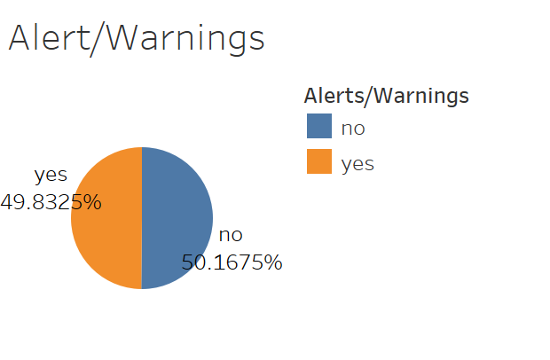
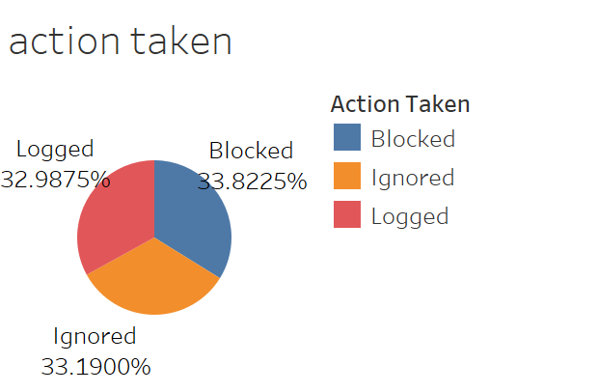
Cyber Attack Prior Alert/Warning and Action Taken

Slide 5
Geo-Location Analysis

Slide 6
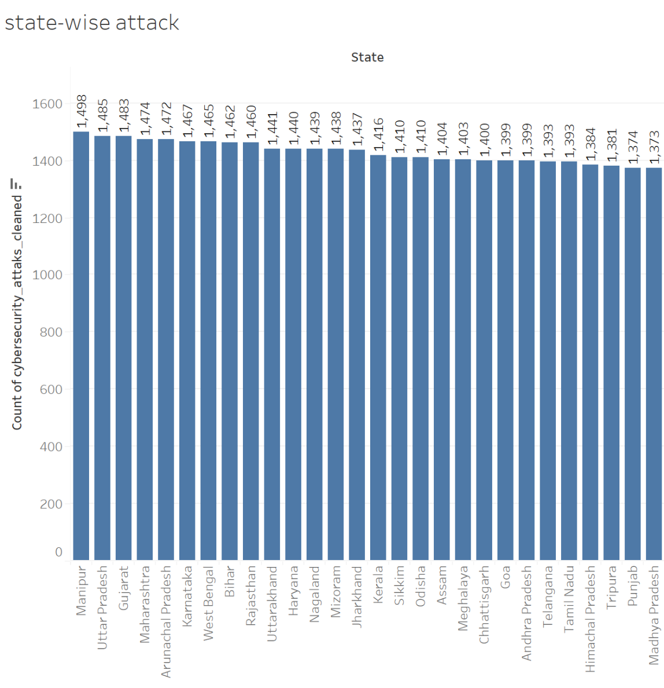
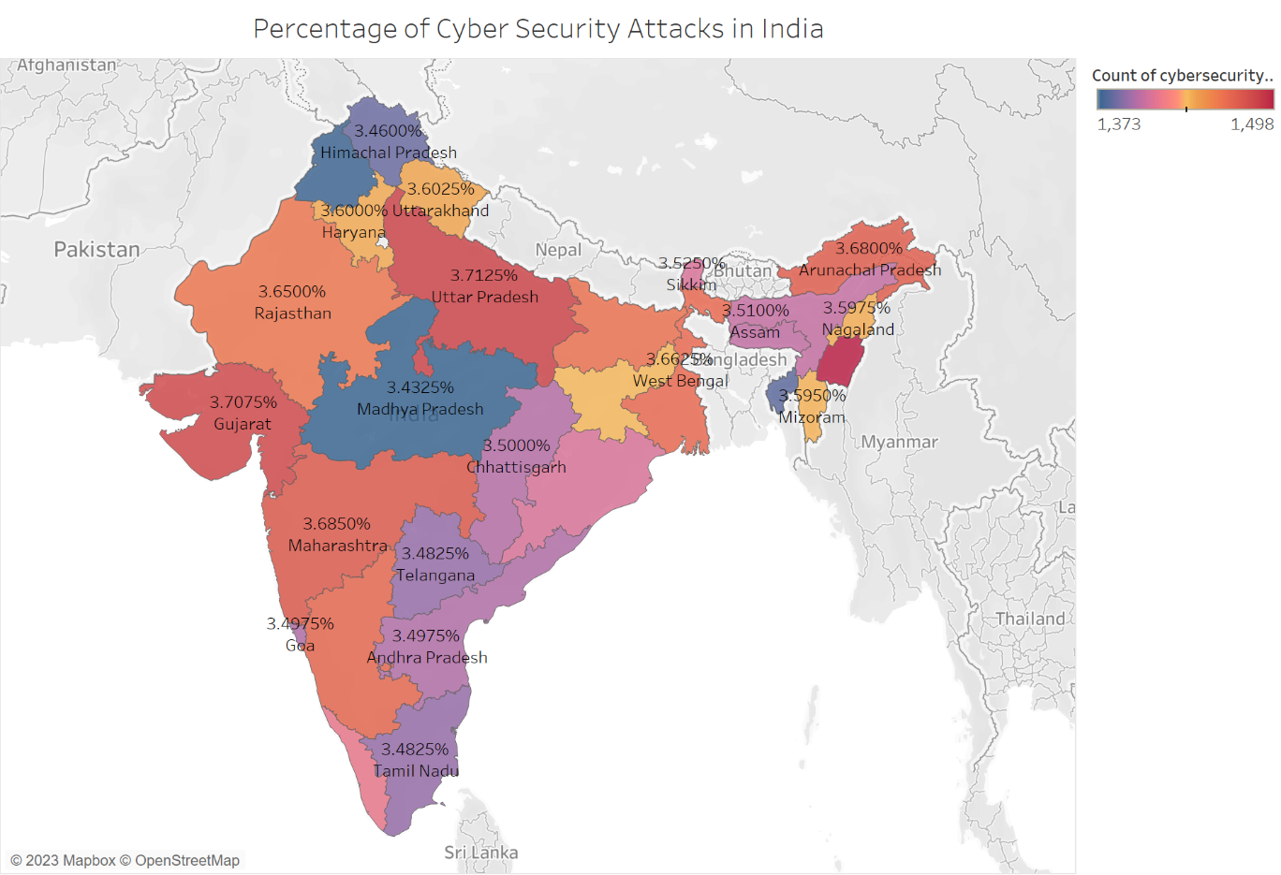
State-wise Cyber Attacks Count

Slide 7

Word Cloud of the Geo-location Data

Slide 8
Device Information Analysis

Slide 9
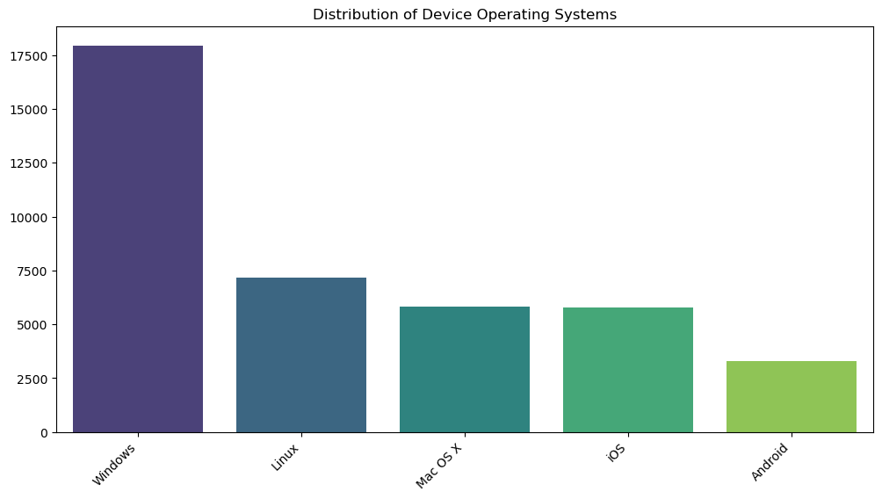
Device Operating System Cyber Attacks Count

Slide 10
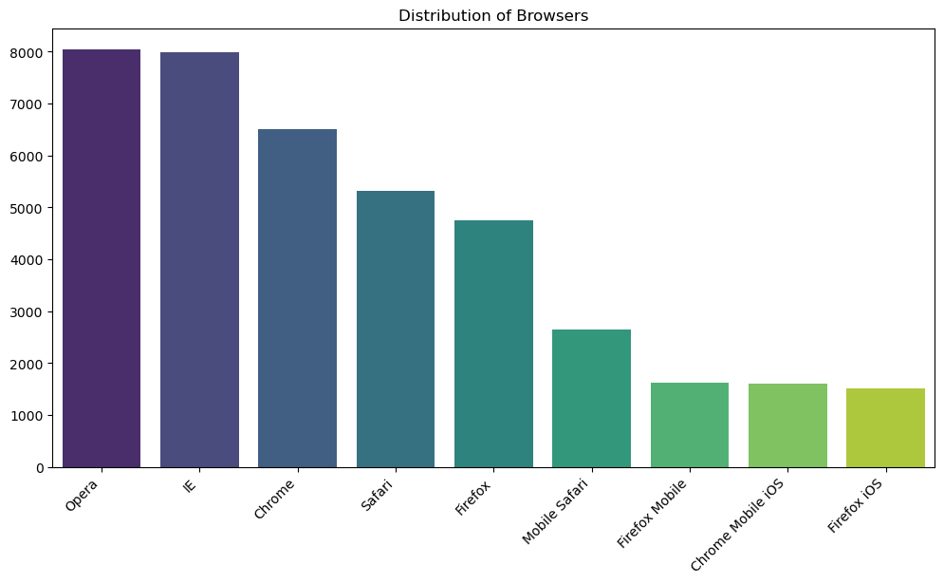
Brower Cyber Attacks Count

Slide 11
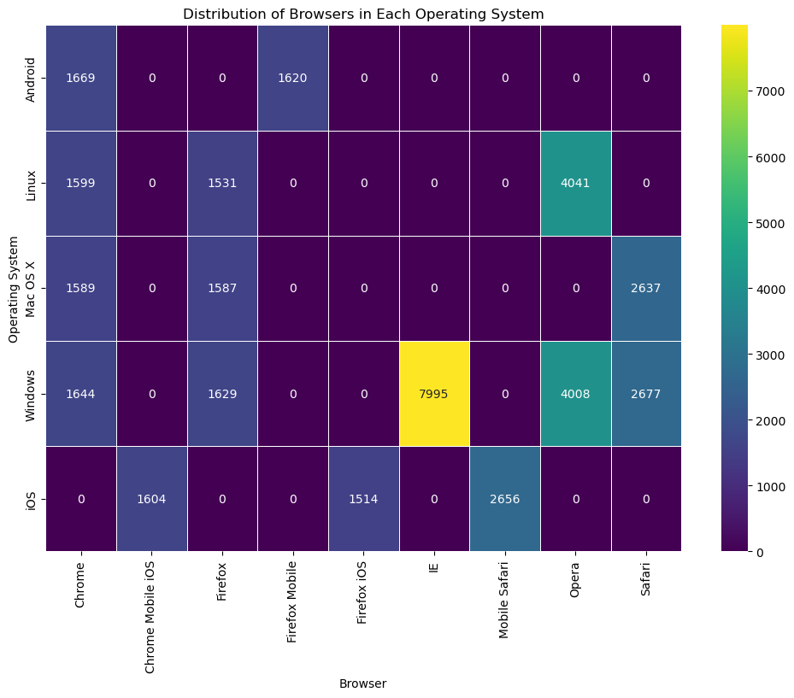
Heatmap of Device Information Data

Slide 12
Statistics of Numeric Measures

Slide 13
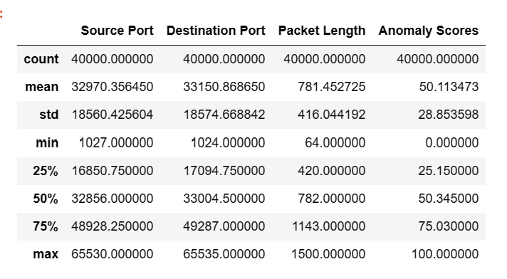
Useful Statistics to Detect Odd Patterns

Slide 14
Statistics Results Interpretation
The source port scores showcase a diverse array of communication channels, reflecting an average source port number of approximately 32,970.36 and a broad spread denoted by a standard deviation of around 18,560.43. Ranging from 1,027 to 65,530, the source port variations suggest a multitude of origins for network traffic. Anomalies in source port behavior may signal irregularities or security threats.
Analyzing destination ports reveals a dynamic range of communication endpoints, with an average destination port number of about 33,150.87 and a notable spread indicated by a standard deviation of approximately 18,574.67. The variability in destination ports, spanning from 1,024 to 65,535, signifies a diverse spectrum of services or devices receiving network traffic.
Packet length analysis indicates a dynamic range of communication endpoints. With an average length of approximately 781.45 and a moderate spread (standard deviation ≈ 416.04), packet lengths vary from 64 to 1,500.
The anomaly scores column provides a comprehensive view of deviations from expected patterns. With an average score of approximately 50.11 and a moderate spread (standard deviation ≈ 28.85), scores range from 0 to 100. Elevated anomaly scores, approaching the maximum, signal significant deviations from the expected norm, potentially indicating security threats or anomalous network activities.

Slide 15
References
https://www.kaggle.com/datasets/teamincribo/cyber-security-attacks
https://www.kaggle.com/code/raman209/cyber-attack-data-exploration
https://www.kaggle.com/code/mikedelong/synthetic-data-eda/input

